Slide 1
Annual
Inspection
Certification
Program
(AIC)
Jacinta Wong
2018

Slide 2
PARTICIPATION
All Central Business District properties
Sister Agencies
Opted – in properties outside the CBD
Other Mandated Buildings

Slide 3
INSPECTORS
AIC Inspectors
Annual inspections conducted by independent third-party State of Illinois licensed inspectors working for a state licensed inspection company registered with City of Chicago AIC program

Slide 4
OVERVIEW
Overview
Compliance can only occur via the online portal
Owner can manage all of their properties and devices from a single user account
Owner confirms list of equipment at property
Inspector confirms equipment details and condition upon inspection
Once devices pass inspection, owner pays fees, prints Certificate of Compliance and posts certificate onsite

Slide 5
ENHANCEMENTS
AIC Changes
Requirement to pass inspection
Quarterly deadlines
Extension certificates
Individual device reporting
Regularly scheduled updates to AIC system
Requires more interaction between AIC and inspection companies

Slide 6
COMPLIANCE REQUIREMENT
Compliance Requirement
All elevators and other mandated conveyances must pass inspection on a yearly basis
Required repairs should be completed within 60 days or by deadline, whichever comes first
All fees must be paid by the due date and certificates posted

Slide 7
QUARTERLY DEADLINES
New Deadline Dates
Compliance is required by the quarterly due date assigned to a building.
Due dates are still changing but properties will always have a minimum of 6 months to complete inspections before their due date.

Slide 8
EXTENSION CERTIFICATES
Extension Certificates
May be requested if device fails initial inspection and compliance is not possible before due date.
Extension certificate will grant property an additional 60 days past the original due date to bring device into compliance.
Additional fees will apply and must be paid for before the due date.

Slide 9
DEVICE ACCOUNTS
Multiple Device Accounts
Multiple user accounts can be created to manage different building devices within a single property.
All devices within a building must be on the property account no matter who owns or manages the devices

Slide 10
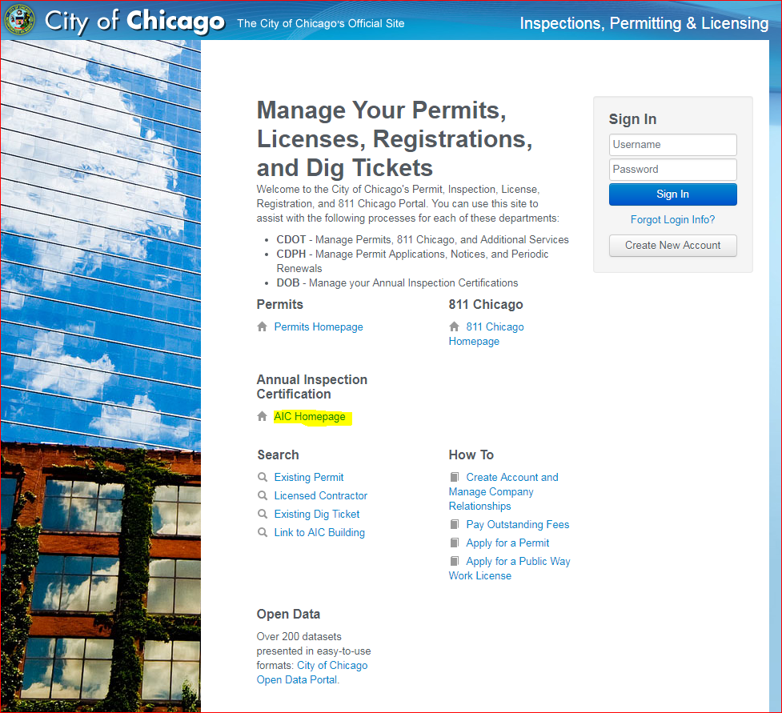
WEBSITE
Website
https://ipi.cityofchicago.org/Profile

Slide 11
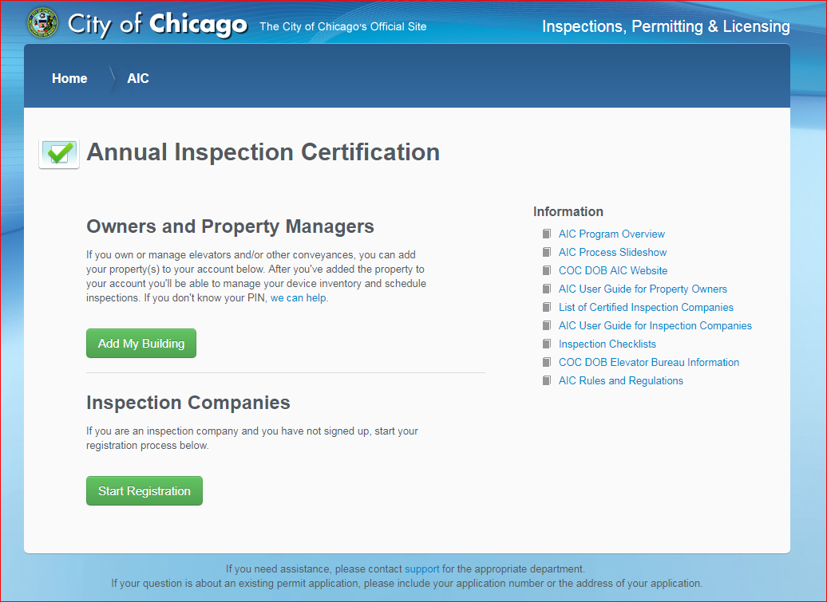
AIC HOMEPAGE
AIC Homepage
https://ipi.cityofchicago.org/AIC#/

Slide 12
OWNER PROCESS
New Owner Process
Customer contacts inspection companies to conduct inspections
Owner contracts with an AIC registered inspection company
Owner is responsible to set up a user account and link that account to the property being inspected
Owner or inspection company to contact AIC to get the Verification PIN# for the building
Account is created, building linked, devices claimed and inspection company assigned online

Slide 13
OWNER PROCESS
New Owner Account Setup
In order to create your AIC account, complete the steps below. Please note that you must use a modern browser such as Google Chrome (Version 51 or greater), Apple Safari (Version 9.1.1 or greater), Internet Explorer (Version 11 or greater) or Mozilla Firefox (Version 46 or Greater)
1. Account Creation:
a. Navigate to https://ipi.cityofchicago.org/Profile
b. Click the "Create New Account" button.
c. Enter your email address and click the "Submit" button. Please note you will receive important information about the inspection process at this email address.
d. An automated message will be sent to the email address you provided. Click on the link in the email to begin the account setup.
e. Follow the onscreen instructions to create your new user access and finish setting up the property account. Please note the contact information you enter here will be listed on the building for other AIC participants.
2. Register Building
a. Navigate to and bookmark the following URL: https://ipi.cityofchicago.org/AIC. Please note the helpful links on the right-hand side of this page.
b. Click on the "Add My Building" button. If you are not already logged in to the website, you will be asked to do so.
c. Enter the PIN below into the corresponding field on the website, and click the "Lookup" button. Please note this is unique to the AIC program, and not your Cook County Property Identification Number.
i. PIN: MUST EMAIL AIC FOR VERIFICATION PIN FOR PROPERTY
d. You will then be shown the address of the building, as well as any other AIC participants who are or have been located at the building. Review this information to make sure you are linking to the correct building.
e. Once you've confirmed you're looking at the correct building, select your relationship to the building from the dropdown and click the "Confirm" button
3. Inventory / Claim Devices
a. Once at your buildings device list, you must claim any and all existing devices which you are responsible for. before you can take any further action

Slide 14
OWNER PROCESS
Owner Process
Account owner logs into website and claims equipment.
Owner contracts with an AIC registered inspection company
Owner assigns devices to contracted inspection company via the web portal.

Slide 15
INSPECTION PROCESS
Inspection Process
Inspection company receives assignment online and assigns inspector to inspect device(s).
Inspector inspects the assigned device(s) and leaves a copy of inspection report with property
Inspection results must be entered into AIC portal within 5 business days.

Slide 16
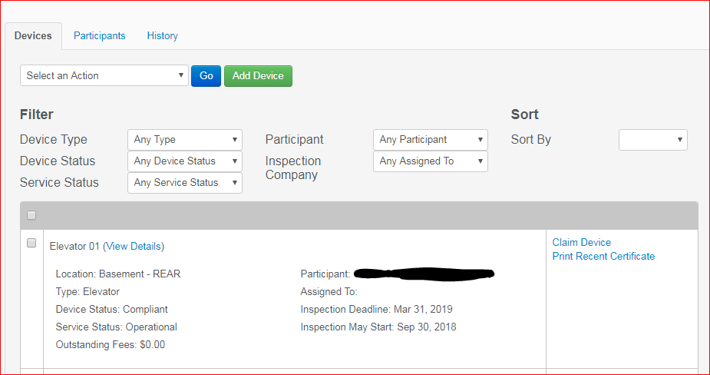
INSPECTION PROCESS
When can inspections occur?
On website - Every property shows its due date
Every device shows even more information
Inspection may start date = when you can begin assigning and inspecting

Slide 17
RESULTING PROCESS
(PASSED)
Resulting Process - Passed
If device complies:
Inspector certifies device passed inspection.
Owner/Inspection company pays AIC program fee through the website.
Owner downloads and prints Certificate.
May be a 30 minute to 1 hour delay in downloading certificates once fees are paid due to the payment having to be processed by the Department of Finance before the certificates can be released
Owner displays certificate at device.
All steps must be completed by due date to be compliant

Slide 18
RESULTING PROCESS FAILED: MINOR REPAIRS
Resulting Process –
Failed (Minor Repairs)
If device fails requiring minor repairs:
Inspector notifies owner of necessary repairs required for compliance
Inspector reports that device failed on AIC portal
Owner contacts maintenance company to make necessary repairs
Owner requests re-inspection to confirm subsequent compliance
Inspector reports compliance if the device passes
Owner pays AIC fee, prints and displays Certificate of Compliance
All steps must be completed by due date to be compliant

Slide 19
RESULTING PROCESS
FAILED: PERMIT REQUIRED
Resulting Process –
Failed (Permit Required)
If device fails needing a permit:
Inspector notifies owner of necessary repairs required for compliance
Inspector reports that device failed on AIC portal
Owner contacts elevator company to pull necessary permits required for repairs
Elevator Company pulls permit, makes repairs and contacts Elevator Bureau to inspect permit work.
When all repairs are completed and permits are finaled, owner/elevator contractor needs to provide copy of finaled permit to inspection company
Inspection company must verify that permit repairs were what was needed to pass inspection and emails AIC with permit information to close permit review for affected devices
AIC approves permit review so inspection can progress
Owner pays AIC fee, prints and displays Certificate of Compliance.

Slide 20
If You Cannot Comply By Deadline Date
Extension Certificates
If violations are cited for your devices (either repairs required/permit required/permit and repairs required) - and you cannot make all the necessary repairs before your deadline date, owners may purchase an extension for those devices prior to your deadline date.
An extension certificate will allow you an additional 60 days beyond your due date to make all required repairs, pass inspection, pay for your AIC fees and print your certificates.

Slide 21
MODERNIZATION
Modernizations
Owner hires licensed elevator contractor to pull modernization permit.
Inspection company reports the device(s) that are under mod permit, inspecting any that are not under permit.
Once devices are reported, AIC fees are generated.
Owner pays AIC fees.
Owner prints and displays available certificate at the device.
Modernization permit needs to inspected annually and finaled by Elevator Bureau inspectors.
AIC 3rd party inspections resume the following inspection cycle after permit is finaled.

Slide 22
DECOMMISSION
Decommission
Account holder hires licensed elevator contractor to pull the permit to decommission the device
City inspector verifies that elevator has been safely and properly decommissioned and finals the permit
Account holder notifies AIC that device has been properly decommissioned and AIC can expire device from account

Slide 23
OUT OF SERVICE
Out of Service
Owners can have devices marked as Out of Service if:
Device is not operational 300 days out of the year
Inspection company verifies that devices are not being used and are inoperable
Owners then pay the AIC Fee for the year – no certificate issued
NOTE: Devices can only be marked as Out of Service for a maximum of two years – device needs to be either permanently decommissioned or repaired, returned to service and inspected

Slide 24
AUDITS
Payment Issues
If you are having trouble with your fees not processing on website:
The Problem may be your bank does not have the proper ACH number for the City to clear your payment
DEPT OF FINANCE ACH NUMBER:
7466005820

Slide 25
AUDITS
Audits
2 types:
Randomly Selected AIC devices
For Cause inspections
i.e. 311 complaints
Failing an Audit
May lead to enforcement actions

Slide 26
ENFORCEMENT - AIC Inspectors and Companies
Enforcement
AIC Inspectors and Inspection Companies
Any inspector or inspection company found to be in violation of the AIC rules may be penalized
Disciplinary action may include but are not limited to:
Enforcement action filed before Cook County Circuit Court
Expulsion from the AIC Program
Revocation of certification
Any other remedy provided by law

Slide 27
ENFORCEMENT - Buildings
Enforcement - Buildings
Administrative Hearing
Any properties not in compliance by the due date may be prosecuted.
Circuit Court
Any properties with equipment deemed to be dangerous and hazardous may be prosecuted.

Slide 28
AIC IS MORE THAN JUST INSPECTING
Customer Service
Helping customers, you should be the first line of help for customers NOT AIC
MAKE SURE:
You help customers set up online accounts
Devices are correctly reported
Devices are assigned online
Customers understand the system and its requirements
Customers get necessary permits (and that permits are being finalized and reviewed!)
Customers pay fees on time
Customers stay on track for due dates
Know what is going on with properties and devices
Status
What needs to be done
MORE THAN JUST INSPECTING

Slide 29
RESPONSIBILITIES OF INSPECTION COMPANIES
RESPONSIBILITIES
MUST report online within 5 business days of inspection
If you are having any trouble reporting contact AIC immediately
MUST follow up on clearing permit reviews
AIC doesn’t know what you required a permit for, so you MUST email AIC to verify any issue and that passed permits fulfill permit requirements
IF we find inspection companies are not properly reporting req permits (especially regarding fire service) and it is found in an audit, we will take action against companies for not complying to AIC standards
MUST make sure all licenses are current
IF expiration is coming up make sure the city has renewal information
Respond to Audit Violations
All inspection companies should be responding to audit violations if there are any questions or concerns about violations. Please let your customer know that until all audit violations are cleared by the City they cannot proceed with any further AIC inspections for the audited device.

Slide 30
ADDITIONAL INFO & CONTACTS
For support and questions-
Email: aic@cityofchicago.org

